Slide 1

Object Orientated Software Engineering
3.2 Class Diagrams, Encapsulation, and Abstraction
By Stephen Lindsay

Slide 2
Outline
Unified Modelling Language (UML) Class Diagrams
The 4 Principles in OOP
Encapsulation
Abstraction

Slide 3
Recommended Reading
If you want to start to see how OO principles like these interact with the course ahead, consider reading Chapter One of Head First Design Patterns by Eric Freeman (2009).
If you scored ok but not perfect, the OO Programming Concepts chapter might be all you need to look over: Interactive OO Programming in Java by Vaskaran Sarcar (2020).
You can also start with a lightweight online introduction to the concepts to refresh yourself: The Four Pillars of OO Programming.

Slide 4
Java Basics: CodeWars
An online site that lets you improve your skills in a wide range of language - it’s especially useful when learning to program because of:
How many languages you can work with
The frequency you can practice with – one exercise a day is better than 7 once a week or 30 once a month!
The gradual increase in difficulty of challenge
The community discuss solutions
The ability to take on friends to stay motivated

Slide 5
Class Diagrams
Class diagrams in Java are a Blueprint or Model of the system that you are building
They can help you map out the design of a system
They can help you understand what you have built
They can give a visual map of the system when well organises
We use Unified Modelling Language to produce our diagrams
Class notation and entity relationships are the key elements to understand
Also important to not get caught up in the details of UML – the abstraction away from details matters

Slide 6
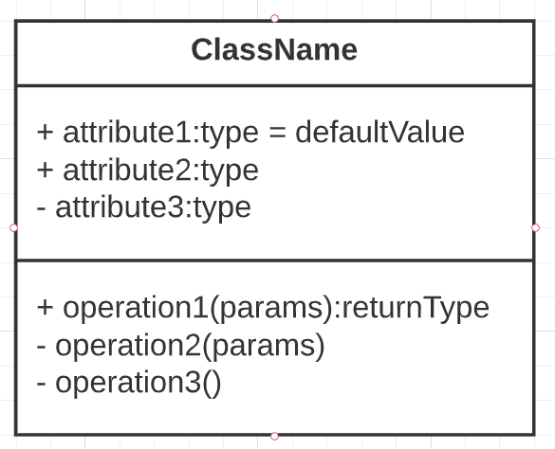
Class Notations
ClassName: the name of the class
Attributes: The data that the class stores
Type tells you if it is a String, integer, Boolean, etc.
A “+” means it is Public, a “-” means Private
Default values tell you what the variable is initialised to
Operations: the methods within the class
In addition to the same +/- notation, their input parameters and return type (if any) are specific

Slide 7
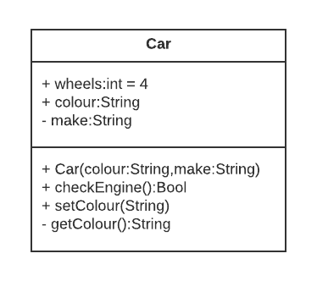

Slide 8
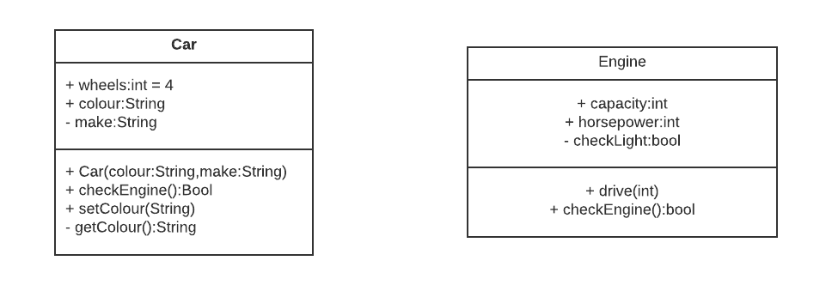

Slide 9
Entity Relationships
Our designs tend to be made up of more than one class and so we want to show they relate to one another
When a class has a relationship with another class, the connection between them denotes the type of relationship they have
A car has an engine class variable but we don’t put that in the list of variables, instead we show it with an arrow

Slide 10
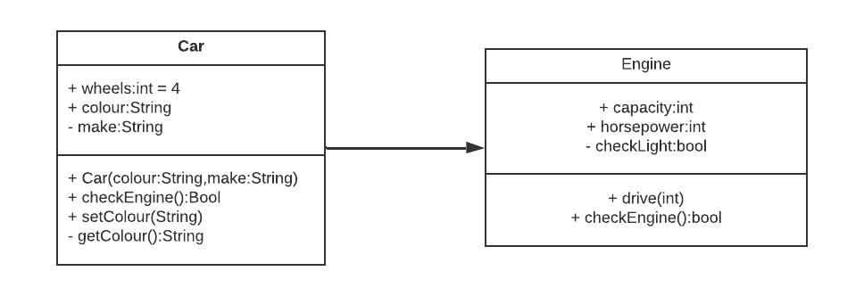

Slide 11
Entity Relationships
The arrow indicates that a car has a single engine, makes sense so far
But hang on a second, does an engine also have a car that it’s put in?

Slide 12


Slide 13
Association in UML
We commonly find that the relationship between two classes is two directional
A line with a pointed arrowhead indicates an association and a line with no arrowhead indicates a two-way association
But while a specific make of car has only one type of engine (only sort of true but let’s roll with it for now) the same engine can be put into many different types of car
This brings us to the final element of association, the use of * to indicate a “many to…” relationship
A * at both ends of an association diagram indicates a “many to many” relationship

Slide 14
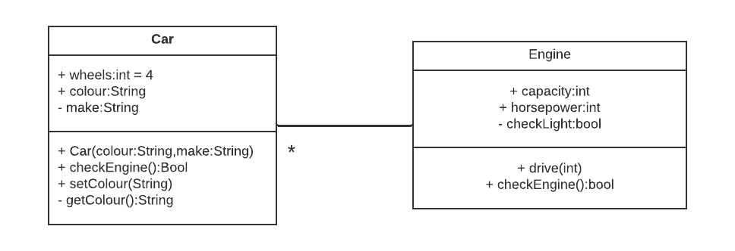
Entity Relationship

Slide 15
Abstraction
Association is one of many relationships that we can indicate in UML class diagrams
To understand the others though, we need to start working our way through the four OOP principles:
Encapsulation
Abstraction
Inheritance
Polymorphism

Slide 16
Principle 1: Encapsulation
Encapsulation is the bundling of data with the methods that operate on that data while restricting direct access to an object’s components
Why do we want to make it difficult to directly alter the data within an object?
Start from the perspective of working in a large group of people or coming back to your code after a long time away from it….

Slide 17


Slide 18
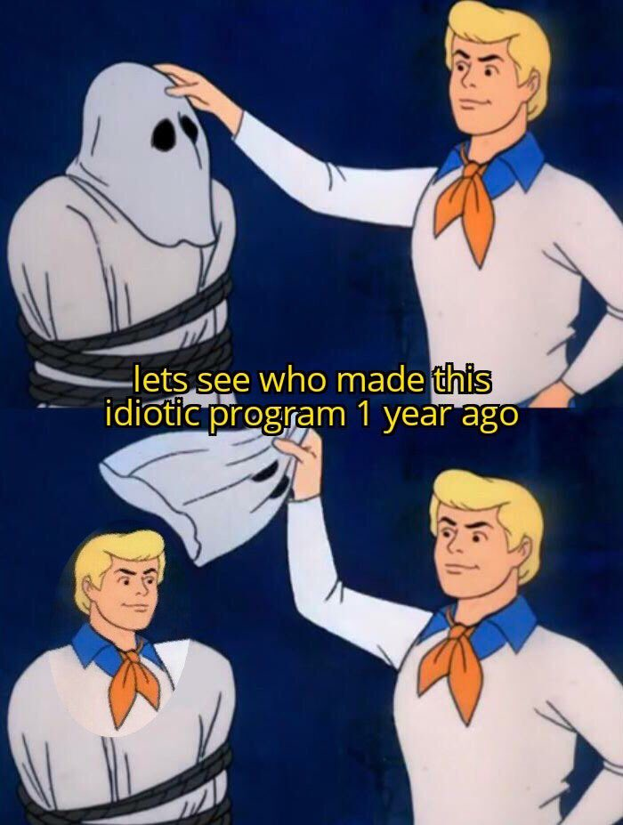

Slide 19
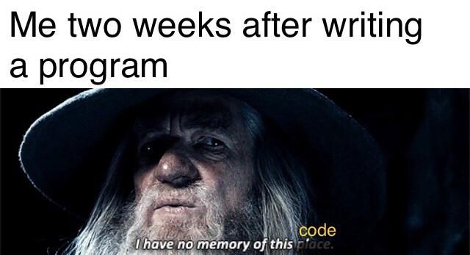

Slide 20


Slide 21
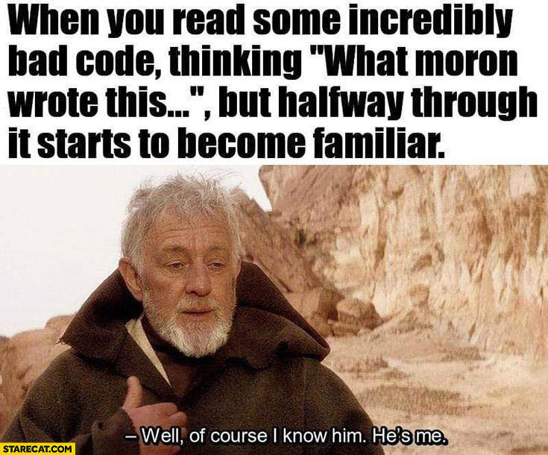

Slide 22
Encapsulation’s Benefits
Granular control – If a variable is public, you allow anyone to get and set it, if you keep it private you can implement getter and setter methods or just one or the other
Data integrity - By keeping the logic to change data within the object the data is stored in, and not permitting change elsewhere, you can ensure that the class controls what is stored in it
Maintainability – When a change needs to be made to data stored within a well-encapsulated class, you don’t need to worry as much about breaking other classes that depend on it

Slide 23
Encapsulation: Example
Imagine we making a bank account to store data and it looks something like this:
public class BankAccount
{
public int acctnum;
public int balance = 0;
public boolean isforeign = false;
}

Slide 24
Encapsulation: Example
addMoney(int add)
{
bankRecord.get(customerAccountNumber).
balance += add;
}

Slide 25
Encapsulation: Example
Imagine that consumers could choose to never go overdrawn - how would you make sure that the account can’t become negative?
What would you do if you realised you needed to change to using a float rather than int value to accurately store the amount in the account?
If the law changed and you needed to have three different international categories (foreign, domestic and commonwealth) what would you do?
Suddenly having a getBalance() and setBalance() method in BankAccount to store all that code in sounds kind of handy!

Slide 26
Encapsulation: How to?
Java provides us with some simple tools to achieve encapsulation – public and private
Start narrow in scope! Make it private by default when you program
When you find that access is needed, then it’s time to write a get or set method
Don’t be too literal about get and set either, the Bank Account example might have addMoney(), withdrawMoney(), and checkBalance()
Notes:
This can feel basic sometimes – you have lots of small, simple classes, but this is the start of good OOP!

Slide 27
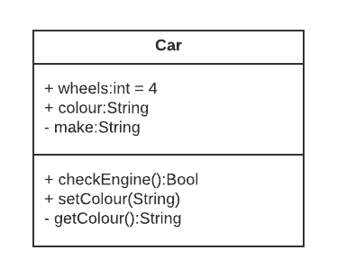
Encapsulation in UML
We’ve actually already covered how to show encapsulation in UML! Remember our +/- symbols?
Basically every variable and method should be a “–” except when it needs to not be
We don’t always show everything in our encapsulation – basic get and set methods for large classes might decrease readability obscuring important functions

Slide 28
Principle 2: Abstraction
Abstraction is the idea of hiding as much detail from our “user” as possible to allow concrete implementations to apply to different but relayed types of data
Abstraction and encapsulation are deeply interlinked concepts, encapsulation packs data and function together, abstraction allows code to operate on similar but different implementations
Taking just a moment, design guides often talk about “users” – they really mean 1) other programmers using our code or 2) us using our code after we forgot how it works!

Slide 29
Abstraction’s benefits
You’re implementing a card game and need to sort the cards in your hand from lowest to highest value:
ArrayList<Card> playerHand;
…
//initialised to store 8 instances of our Card class
…
Collections.sort(playerHand);
How is this possible, how could the people who made the API know how to sort our bespoke Card class?

Slide 30
Abstraction’s benefits
This is the magic of abstraction! Ignore the code for a second and consider the idea:
They don’t know about our Card class
We don’t know about the internals of their sort method,
But we both know about an abstract idea - being comparable
Being comparable means being able to look at another thing like you and always say whether you are bigger, the same size or smaller than it
If we can do that in our class, they can organise a list

Slide 31
Abstraction in Java
Java offers two ways to be abstract, abstract classes and interfaces, we’ll focus on interfaces:
public interface Animal
{
String getSound();
}
Abstract classes will be revisited in inheritance – don’t ask why just yet!

Slide 32
Abstraction in Java
public class Cat implements Animal{
public String getSound()
{ return “Meoww”;}
public void scratchPost(){…}
public class Dog implements Animal
public String getSound()
{ return “Woof”;}
public void chaseCar(){…}

Slide 33
Abstraction in Java
// We fill pet list with dogs, cats and
// guinea pigs
List<Animal> pets = generatePetList();
…
// a car alarm goes off down the street…
public void bedlam()
{
… //some code to iterate through pets
print(pets.get(i).getSound());
}

Slide 34
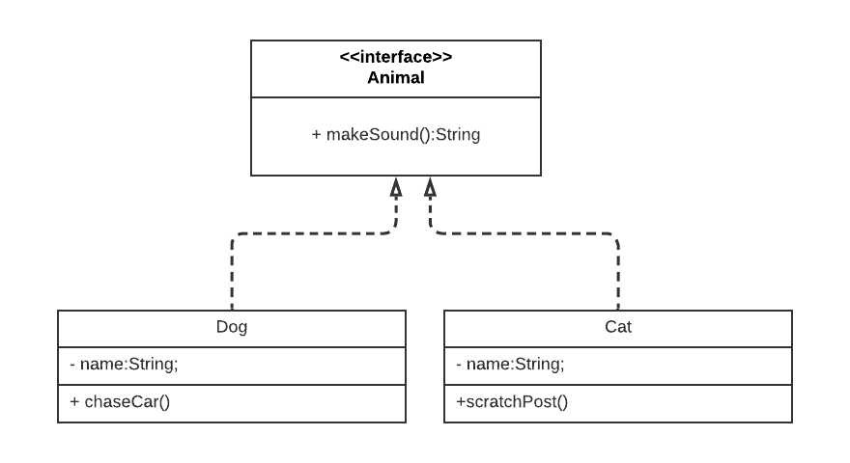

Slide 35
Dependencies in UML
A dotted line with a hollow arrow represents dependencies in UML
Weaker relationships than associations
Again, we understand when a class is dependent on a interface that it implements it’s methods so we don’t put them in the class notation

Slide 36
Outline
Unified Modelling Language (UML) Class Diagrams – Graphical representations of program structure, don’t get too hung up on them (more to come)
The 4 Principles in OOP – fundamental ideas to improve quality of code, not enough on their own though!
Encapsulation – keep data and function together, don’t let other people touch
Abstraction – exposing interfaces to your code, saying it will do certain things while hiding the details, lets people operate on your classes after only seeing the interface to them

